Slide 1
Building Microservices The Jet Way
Gad Berger
@gadberger
Jet.com
@JetTechnology

Slide 2
What we’ll discuss today
What is a microservice, exactly?
How microservices affect teams
How to write and deploy a microservice
Thoughts on how to handle exceptions

Slide 3
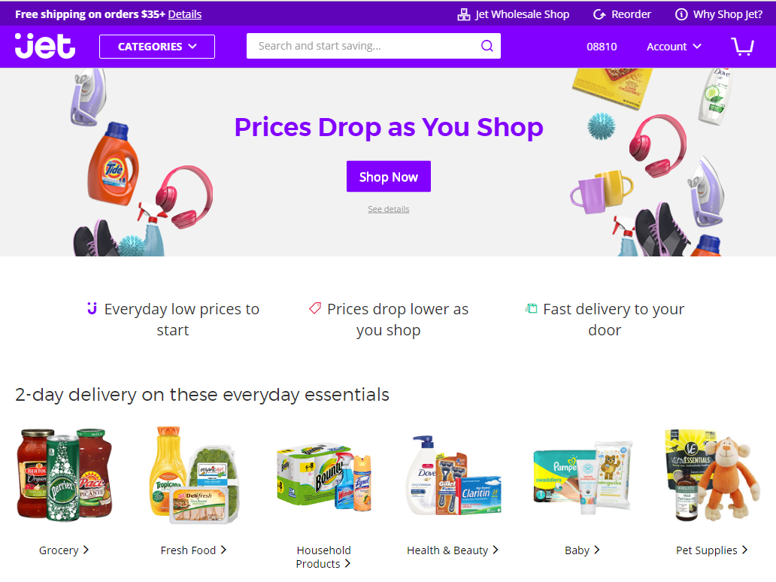


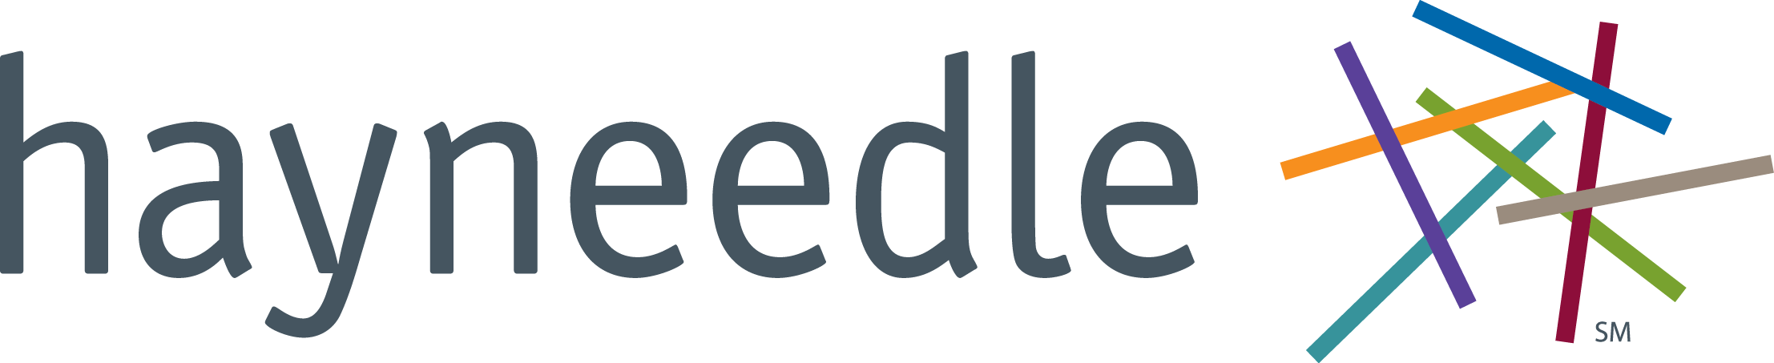
Jet.com
Launched in July of 2015
“We save you money on the things you already buy”
Featured: app store & android store
Over 20k orders per day
Over 15 Million SKUs
Walmart Jet for $3.3B in August 2016!
We’re hiring!
http://jet.com/about-us/working-at-jet
Notes:
We fulfill our own products, and we are a marketplace platform

Slide 4
5-year Goal
$20 Billion in GMV
Do everything at scale

Slide 5
Microservices
Notes:
Monolith - orchestra with a conductor
Microservice – Bees!

Slide 6


Slide 7
Microservice
A service that follows the Single Responsibility Principle.
Perform a single business or system function.
Has an input, produces an output.
EmailOnOrderShipped
UpdateAccountingDb
SendOrderShipmentEmail
NotifyShipmentEmailSent
Sends Email
Benefits
Scalability
Distribution of complexity
Independent releases
Drawbacks
Latency
Difficult to troubleshoot
Increased management overhead

Slide 8
How microservices affect teams
Free to deliver faster, with tighter focus
Settle on a consistent language and pattern
Can introduce some interesting politics
May obfuscate how the system works
Notes:
Large teams competing over same code base can be difficult to manage
Cost of failure can be cheaper
Large teams competing over the same code base can be difficult to manage. MS frees up the teams to deliver faster with tighter focus
Cost of failure is cheaper (most of the time). Fail on one component is easy to roll back or roll
DO NOT START with microservices unless you have a good reason for it
Engineering teams at jet support their own systems. We build on Azure, and the we are responsible for the services that we build. That includes websites, API servers, microservices, databases, messaging platforms, and more.
We settled on F# as our lingua franca

Slide 9
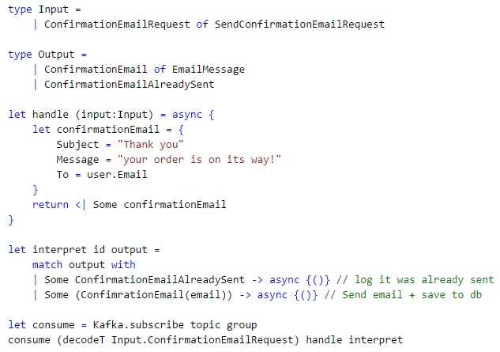
What do our services look like?
Define inputs & outputs
Define how input transforms to output
Consistent language & pattern
Define what to do with output
Process stream

Slide 10
Scoping a service
Again, follow the Single Responsibility Principle
Check if order is already cancelled
Cancel Order
Save order cancellation to DB
Emit OrderCancelled or OrderCancelFailed
let serviceName = “CancelOrderService”
type Input =
| CustomerCancelRequest of OrderID
| FraudSuspected of OrderID
| UnfulfillableOrder of OrderID
type Output = OrderCancelled | OrderCancelFailed
Input
Cancel Order Logic
Output

Slide 11


Handle messages asynchronously
Topic order-shipment-email
Offset | Key | Payload
0 | 123456789 | { “email” : “order confirmation” }
1 | 445879613 | { “email” : “order confirmation” }
http://kafka.apache.org
Stream CustomerOrder-123456789
Event | Type | Payload
0 | OrderConfirmed | { “orderId” : 123, “total” : 100 }
1 | OrderShipped | { “when” : justnow, “to” : “awesome customer” }
Event Store
https://geteventstore.com

Slide 12
How messages flow through microservices
Kafka message bus
AwaitingShipment
SendShipmentEmail
SendShipmentEmail
NotifyShipmentEmailSent
ShipOrder
microservice
SendShipmentEmail
microservice
OrderShipped
ShipmentEmailSent
Event Store
Notes:
Example: Gambit used to write shipment emails directly from within the code base. Once we were able to publish our emails to kafka, the marketing team took over, and they went fast! If you shop at Jet, you used to get a shipment email. Once we the marketing team had access to the data, they were able to introduce push notifcations.

Slide 13
Deployment and Lifecycle
- https://jenkins.io
- https://www.nomadproject.io
Jenkins
Nomad
Build
Test
Execution time
Deployment
Deploy
Configuration
Restarts
- https://www.consul.io
Versioning
Scaling
Consul
Service discovery
Configuration + Secrets
Availability
Subsystem
grouping
Notes:
Nomad abstracts away the machines where services run.
You declare what you want to run, and nomad handles where they should be run

Slide 14
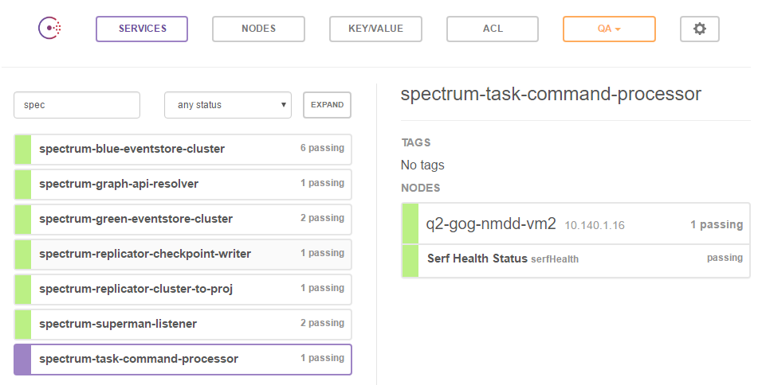
Consul

Slide 15
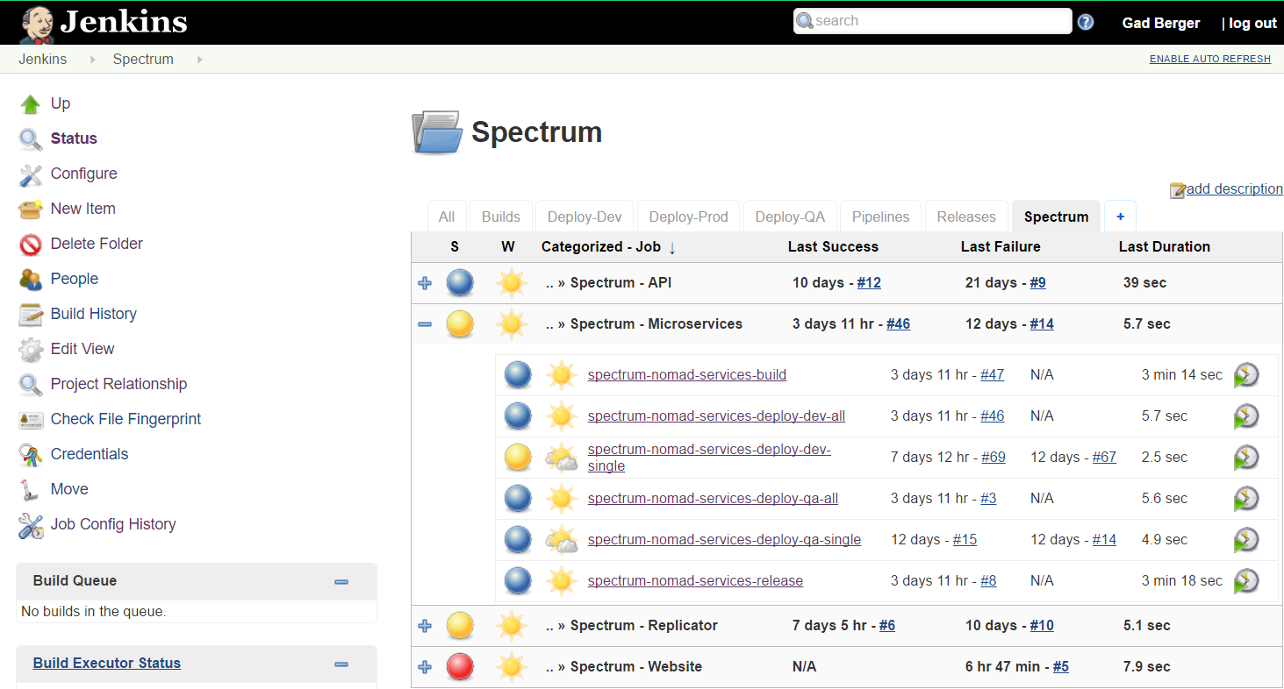
Jenkins

Slide 16
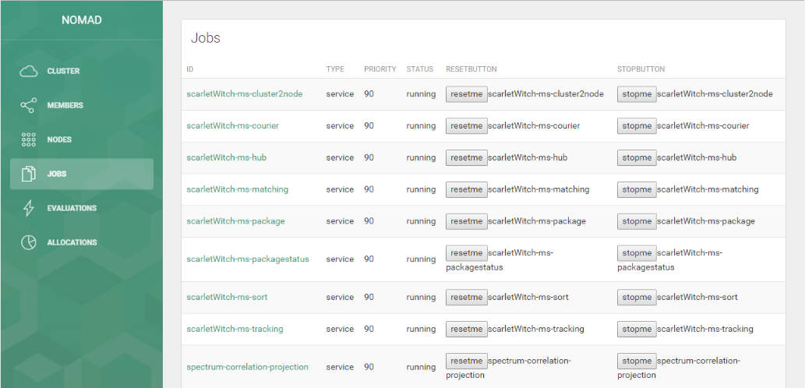
Nomad
- https://github.com/iverberk/nomad-ui

Slide 17
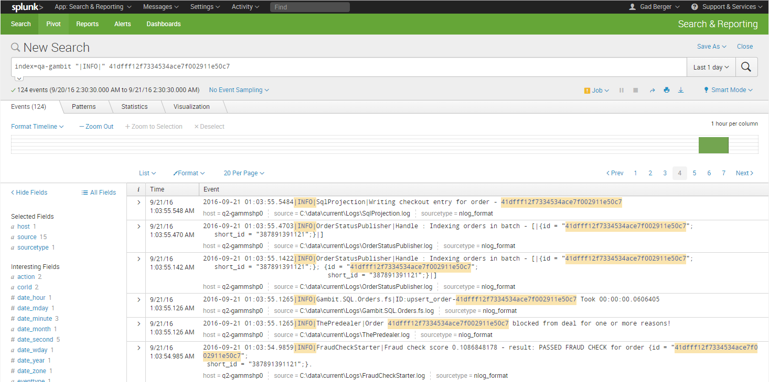
Make sure that you have great logs
Microservices introduce accidental complexity
Distributed systems need actual distribution to flush out bugs
QA environment should be a copy of Production
Log status to a centralized view
Use correlation IDs
Notes:
Complexity moves out of code and into the interconnections between microservices
Logging – set alerts based on log results, not from the app (pager duty storm)

Slide 18
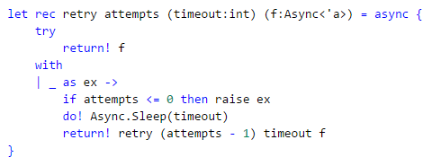
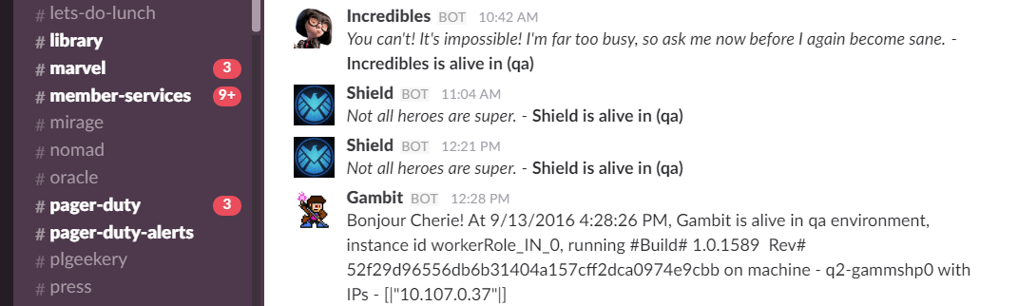
Be prepared for network faults
Networked systems will fail
Wrap network calls in retry logic
Avoid too much backpressure
Infinite retries could seize up a system
Instead use dead letter queues and circuit breakers
Chaos test your services
What happens when your service crashes?

Slide 19
In summary
Single Responsibility Principle
Consistent language & pattern
Message Bus
Logging
Prepare for Network
Faults

Slide 20
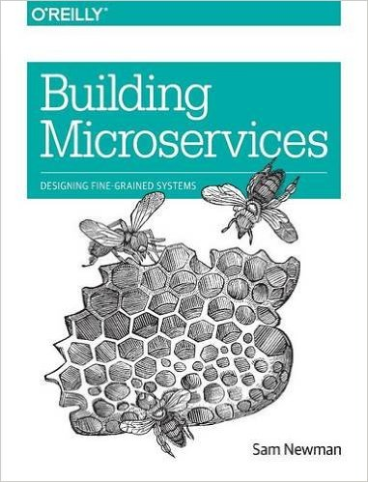
For more information - @gadberger
Microservices
martinfowler.com
microservices.io
Books
Distributed Messaging
kafka.apache.org
Event Sourcing
geteventstore.com
tech.jet.com - Event Sourcing is Awesome!
Building Microservices
by Sam Newman

Slide 24
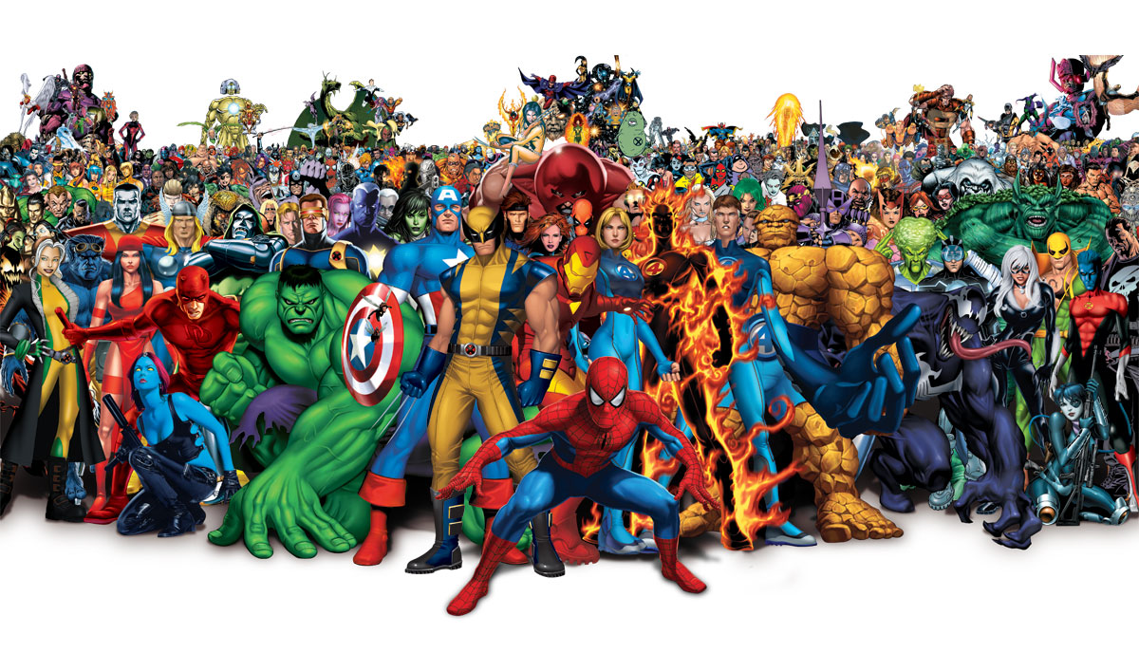
Working with multiple data stores
Event Sourcing
Projections to SQL & Kafka
Caching
Redis, DocDB & Elasticsearch
Messaging
Kafka, Azure ServiceBus
Azure
ServiceBus, Table Storage, Blob Storage, Queues, Document DB
Search
Website
Analytics
Pricing
Order Management
Marketing
Merchant
Fulfillment
Catalog
Notes:
Don’t expose your internal data store to external customers. Provide a separate view or publish events with pre-defined contracts to a message bus.

Slide 25
Populating multiple data stores
Commands
µS
Events
Event Store
Event Store
View
Views
SQL
Redis
DocumentDB
Elasticsearch
Kafka
Event Store
Table Storage
Blob Storage
Event Stream / Queue
Update Projection Service
Kafka
Event Queue
View
Update Projection Service

